Slide 1
CS 408
Computer Networks
Chapter 04: Modern Applications

Slide 2
Hypertext Transfer Protocol
HTTP
What does hypertext mean?
  “a body of written or pictorial material interconnected in such a complex way that it could not conveniently be presented or represented on paper”
  Ted Nelson, 1965
Underlying protocol of the World Wide Web
Can transfer plain text, audio, images, etc.
  actually you can transfer any type of file using HTTP
Most recent version HTTP 1.1 – RFC 2616
  176 pages

Slide 3
HTTP Overview
Transaction oriented client/server protocol
Usually between Web browser (client) and Web server
Uses TCP connections (on port 80)
Stateless
  Server (normally) does not keep any info about client history
  Each transaction treated independently
  New TCP connection for each transaction
  Terminate connection when transaction is complete
  That does not mean that, say, 20 new connections are needed to download 20 different items from a web site.
    It is possible to have “persistent” connections that several items are downloaded back-to-back
Why stateless?
  any idea?
  Hint: it was a design decision due to the nature of transactions

Slide 4
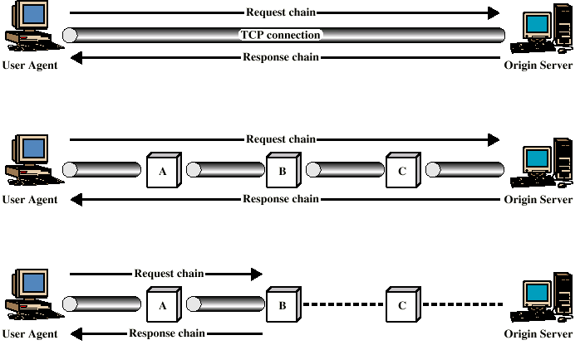
Examples of HTTP Operation
end-to-end direct connection
intermediate nodes such as proxy
use of cache

Slide 5
HTTP Messages
Simple request/response mechanism
Request
  Client to server
Response
  Server to client
First, client opens a TCP connection towards the server at port 80.

Slide 6
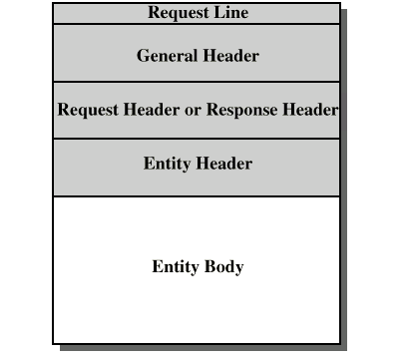
HTTP Message Structure
Response(status) Line /

Slide 7
Request
Request-Line
  Method <SP> Request_URL <SP> HTTP/Version <CRLF>
Several Methods - some examples (see the book for the full list)
  Get
  Head
  Delete
  Put
Example
  GET /index.html HTTP/1.1

Slide 8
General Header Fields
Contain information that is not directly related to data to be transferred
  but mostly directives to intermediate nodes
  some are for connection management
  for example
    Keep-alive: to keep the TCP connection open for a while; needed for persistent connections (shall see persistent connections later)
  can be used for both request and response

Slide 9
Request Header Field
Additional parameters about requests - some examples (see the book for the full list – not responsible for the details)
  Accept charset
  Accept language
  Host
    Identify the domain address if there are multiple domains served by a single HTTP server
  If modified since
    can be used with GET command
  Referrer
    Mostly for advertisement referrals

Slide 10
Response Messages
Status line followed by one or more general, response and entity headers, followed by entity body
Status-Line
  HTTP-Version <SP> Status-Code <SP> Reason-Phrase
  some examples for “status-code – reason-phrase” pairs (see the book for the full list but not responsible for the list)
    200 OK
    404 Not found
    405 Method not allowed
    400 Bad request

Slide 11
Response Header Fields
Additional info about the response
Some examples (see the book for the full list – not responsible)
  Location: exact location of the requested URL
  Server: info about server software

Slide 12
Entity Header
Information about the entity to be sent by the server
  similar to MIME format
Some examples
  Content language
  Content length
  Content type
  Last modified
  etc.

Slide 13
Entity Body
Arbitrary sequence of octets that constitutes the transferred entity (actual data)
HTTP transfers any type of data including:
  text
  binary data
  audio
  images
  video
Interpretation of data determined by header fields

Slide 14
HTTP request message
The rest of HTTP discussion is from Kurose&Ross
ASCII (human-readable format)
Example:
request line
(GET, PUT,
HEAD, etc. commands)
GET /somedir/page.html HTTP/1.1
Connection: close
Host: www.someschool.edu
User-agent: Mozilla/4.0
Accept-language:fr
(extra carriage return, line feed)
header
lines
Carriage return,
line feed
indicates end
of message
First open a TCP connection (you may use telnet for this) to the host at port 80

Slide 15
HTTP response message (example)
status line
(protocol
status code
status phrase)
HTTP/1.1 200 OK
Connection close
Date: Thu, 06 Aug 1998 12:00:15 GMT
Server: Apache/1.3.0 (Unix)
Last-Modified: Mon, 22 Jun 1998 …...
Content-Length: 6821
Content-Type: text/html
data data data data data ...
header
lines
data, e.g.,
requested
HTML file

Slide 16
HTTP connections
Nonpersistent HTTP
Only one object is sent over a TCP connection.
HTTP/1.0 used only nonpersistent HTTP
Persistent HTTP
Multiple objects can be sent over single TCP connection between client and server.
HTTP/1.1 uses both persistent and nonpersistent connections

Slide 17
Nonpersistent HTTP (over an example case)
(contains text,
references to 10
jpeg images)
Suppose user enters URL www.someSchool.edu/someDepartment/home.index
1. HTTP client initiates TCP connection to HTTP server (process) at www.someSchool.edu on port 80
2. HTTP server at host www.someSchool.edu waiting for TCP connection at port 80. “accepts” connection and notifies client
3. HTTP client sends HTTP request message into TCP connection socket. Message indicates that client wants object /someDepartment/home.index
time
4. HTTP server receives request message, forms response message containing requested object, and sends message into its socket. After that, server closes TCP connection
5. HTTP client receives response message containing html file, displays html. Parsing html file, finds 10 referenced jpeg objects
6. Steps 1-5 repeated for each of 10 jpeg objects

Slide 18

Response time modeling
Definition of RRT (round trip time): time needed for a small packet to travel from client to server and back (basically 2*prop. delay).
Response time:
one RTT to initiate TCP connection
one RTT for HTTP request and first few bytes of HTTP response to return
file transmission time
total = 2RTT +
file transmission time
initiate TCP
connection
RTT
request
file
RTT
time to
transmit
file
file
received
time
time

Slide 19
Persistent HTTP
Nonpersistent HTTP issues:
requires 2 RTTs per object (plus the transmission time)
but browsers often open parallel TCP connections to fetch referenced objects
Client and server should allocate resources for each TCP connection
Persistent HTTP
server leaves TCP connection open after sending response
subsequent HTTP messages between same client/server are sent over this connection

Slide 20
Pipelining in Persistent HTTP
Persistent without pipelining:
client issues new request only when previous response has been received
one RTT for each referenced object (plus the transmission time)
Another RTT is needed for TCP connection, but this is only once for the entire connection
Persistent with pipelining:
default in HTTP/1.1
client sends requests as soon as it encounters a referenced object
as little as one RTT for all the referenced objects (plus the transmission times)
  Another RTT plus the transmission time may be needed for the main object where the references are learnt
Another RTT is needed for TCP connection, but this is only once for the entire connection
Now let us see some examples on board

Slide 21
Cookies: keeping “state”
Many major Web sites use cookies to remember their clients
Four components:
  1) cookie header line in the HTTP response message
  2) cookie header line in HTTP request message
  3) cookie file kept on user’s host and managed by user’s browser
  4) back-end database at Web site
Example:
- Susan access Internet always from same PC
- She visits a specific e-commerce site for the first time
- When initial HTTP requests arrives at site, site creates a unique ID and creates an entry in backend database using this ID
- One week later, when Susan visits the same site, the site remembers her
this part is adapted from Kurose&Ross, Computer Networking

Slide 22
Cookies: keeping “state” (cont.)
client
Server (amazon)
Cookie file
usual http request msg
server
creates ID
1678 for user
ebay: 8734
usual http response +
Set-cookie: 1678
entry in backend
database
Cookie file
amazon: 1678
ebay: 8734
one week later:
access
Cookie file
usual http request msg
cookie: 1678
cookie-
specific
action
amazon: 1678
ebay: 8734
usual http response msg

Slide 23
Cookies (continued)
What cookies can bring:
Identification
User session state (server remembers where client stopped last time)
Customization
Shopping carts
Cookies and privacy:
cookies allow sites to learn a lot about you
  and may sell this info
advertising companies obtain info across sites about your browsing pattern using banner ads that contain cookies

Slide 24
Internet Directory Services DNS
Domain Name System
  a directory lookup service
  Provides mapping between host name and IP address
  A “must” for proper to functioning of Internet
RFCs 1034 (concepts) and 1035 (implementation)
  1987
  total 110 pages
  Updated by many other RFCs

Slide 25
Internet Directory Services DNS
Four important elements of DNS
  Domain name space
    Tree-structured
  DNS database (distributed)
    The info about each node in name space tree structure is contained in a Resource Record (RR).
    The collection of RRs is organized as a distributed database
  Name servers
    Servers that hold and process information about portion of tree and corresponding RRs
  Name Resolvers
    Programs that help clients to extract information from name servers

Slide 26
Domain Names
32-bit IPv4 addresses uniquely identify devices
  Network number, Host address, later subnet addresses
  Routers route based on network numbers
People tend to memorize names, not numbers
  a naming mechanism is needed
In Arpanet times, hosts.txt file was used
  managed centrally, downloaded by all hosts daily
  become insufficient in time
In the Internet, naming problem is addressed by the concept of domain
  Group of hosts that have common naming elements
    .com domain, .edu.tr domain, sabanciuniv.edu domain
  Organized hierarchically
  Names are assigned to reflect hierarchical organization
    .tr .edu.tr .boun.edu.tr

Slide 27
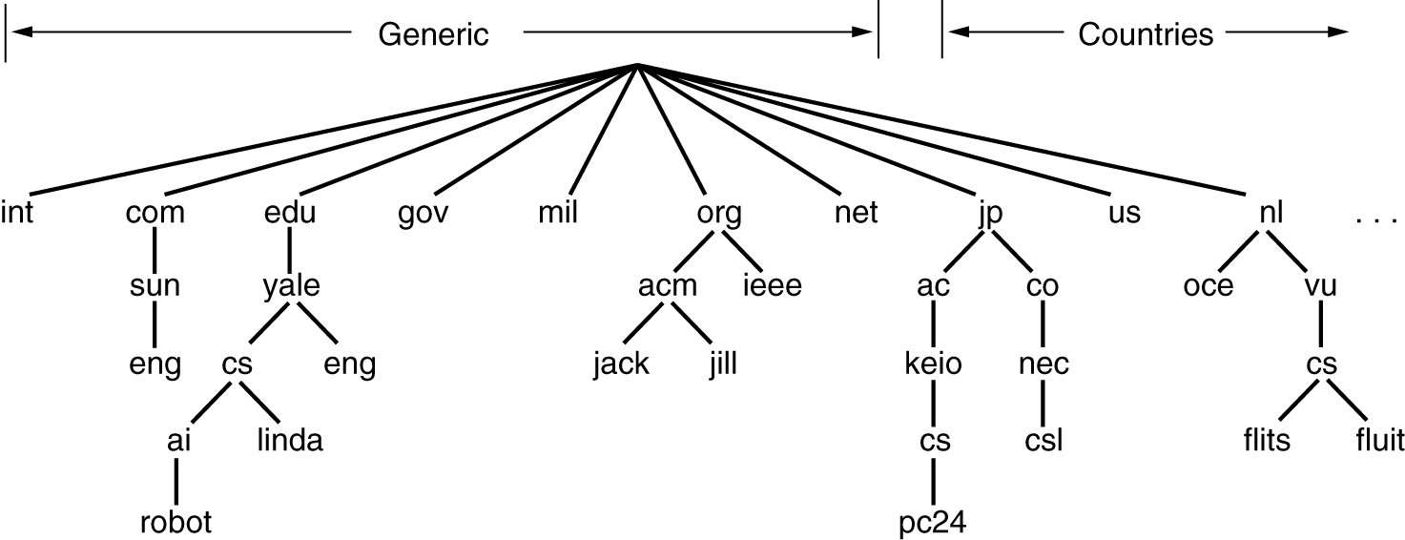
Portion of Internet Domain Tree
Top level domains
over 200 TLDs (including later added ones, e.g. .biz .pro .info)
hierarchy helps uniqueness (explain this in CS terms!)
Do you know the char length limits?
Naming follows organizational boundaries, not physical ones
Notes:
Labels at most 63 chars, Full name at most 255 chars
Case insensitive

Slide 28
Domain Names and Example
Variable-depth unlimited levels hierarchy for names (labels)
  Delimited by period (.)
edu is college-level educational institutions
yale.edu is domain for Yale University in US
  should yale.edu have an IP address?
  not necessary, but it has (104.16.242.46)
cs.yale.edu is Computer Science department at Yale
  has an IP address (128.36.229.18)
Eventually get to leaf nodes
  Identify specific hosts
  Hosts are assigned Internet (IP) addresses

Slide 29
DNS Database
Each TLD and subordinate nodes manage uniqueness of the names that they assign
Management of subordinate domains may be delegated
  down the hierarchy
  In this way, zones are created
Distributed database
  Thousands of zones
  each of these zones are separately managed by different name servers, so distributed database

Slide 30
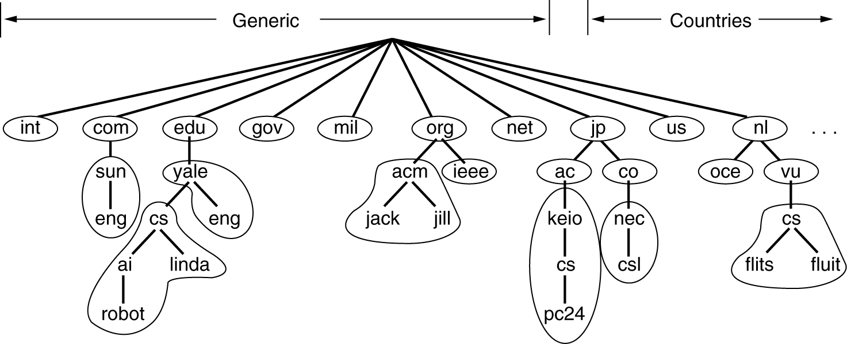
Zones
Each non-leaf node may or may not manage its childs
  cs.yale.edu would like to run its own name server, but eng.yale.edu not
Next: How can we represent a zone in the database?
  but before, we have to understand the structure of resource records

Slide 31
Resource Record - 1
Records in a DNS database are called Resource Records (RRs)
  info about hosts
  there are different types of RRs
Fields of one RR
  DomainName TTL Class Type Value
  Domain name
    Series of labels of alphanumeric characters or hyphens
    Labels are separated by period (“.”)
  Type
    of the RR. We will see now

Slide 32
Resource Record - 2
RR Fields (cont’d)
  Class
    Potentially DNS can be used for naming in several other systems
    Usually IN, for Internet
  Time to live (TTL)
    How long to hold the result in local cache
    Zero means don’t cache
  Value (Rdata)
    Resource data
    For each RR type interpretation is different
      For A type, Rdata is 32-bit IP address

Slide 33
Resource Record Types - 1
A
  Address type. Value of A type RRs is an IP v4 address
AAAA
  Address type for IPv6 addresses
SOA
  Start of Authority
  Parameters (mostly to sync with other servers) and info about this zone
MX
  Mail Exchange
  Value field is the name of the receiving SMTP agent for the Domain_Name
  may be more than one MX RRs for one domain
    Mostly for load balancing for the domains that receive high volume of emails
Notes:
Multiple MX RRs: DNS Server sends out full list list of MX RRs but in different order in every query.

Slide 34
Resource Record Types - 2
CNAME
  Canonical Name
  used to create aliases
  Value field is the canonical host name (for the alias, which is given as Domain_Name)
NS
  Name Server
  Value field is the name of the server who knows the IP addresses of the hosts that belong to the domain given in the Domain_Name field.
  can be used to specify the names of the name servers in both current domain or in subordinate domains (for delegation purposes)
    There might be several DNS servers for each domain for fault tolerance

Slide 35
Resource Record Types - 3
PTR
  Pointer type
  used for reverse lookups
  Domain_Name field is an IP address (but in a differently formatted way); Value is the hostname
HINFO
  Host Info.
  OS and processor type of information about the zone’s server and hosts
TXT
  Textual comments

Slide 36
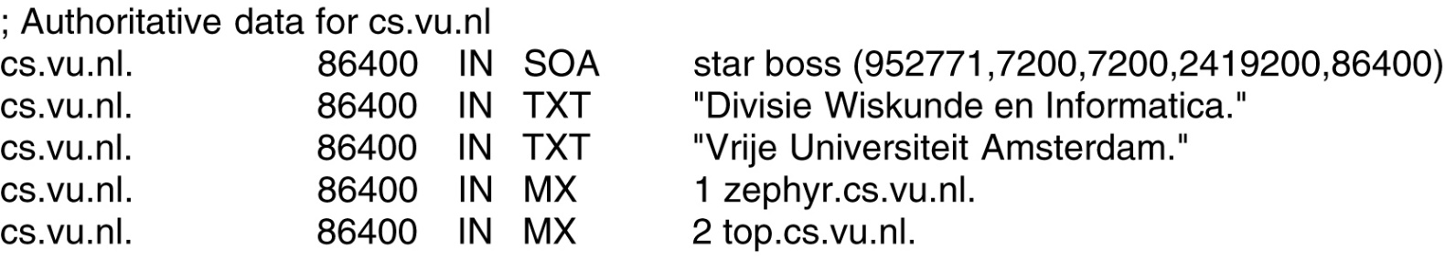

A portion of a possible DNS database for cs.vu.nl.
cs.vu.nl. 86400 IN NS flits.cs.vu.nl.
cs.vu.nl. 86400 IN NS star.cs.vu.nl.
zephyr.cs.vu.nl. 86400 IN A 130.37.20.10
zephyr.cs.vu.nl. 86400 IN HINFO Sun Unix
star.cs.vu.nl. 86400 IN A 130.37.24.6
star.cs.vu.nl. 86400 IN A 192.31.231.42
star.cs.vu.nl. 86400 IN HINFO Sun Unix

Slide 37
Addition to previous example
How to delegate a subzone ai.cs.vu.nl?
Add the following RRs to database for cs.vu.nl
  one is for the name server of the subzone and the other is for that nameserver’s IP address.
  ai.cs.vu.nl. 86400 IN NS dns.ai.cs.vu.nl.
  dns.ai.cs.vu.nl. 86400 IN A 130.37.56.350
These two RRs are together called “glue record”

Slide 38
A Better Example of SOA RR
anynet.com IN SOA dns.anynet.com. admin.anynet.com ( 2018091401 ; Serial
3600 ; Refresh
300 ; Retry
360000 ; Expire
86400) ; Minimum )
Admin’s email address; first dot is actually @
See the notes of this slide for the explanations of these fields
Host name of the primary name server of the zone
Notes:
Serial number: DNS admin changes this value after each update. Generally it reflects update date.
The refresh interval in the REFRESH field is the length of time that a secondary server waits after successful replication of the database before it attempts replication again.
The retry interval in the RETRY field is the length of time that a secondary server waits after an unsuccessful replication attempt before it attempts replication again.
The expiry interval in the EXPIRE field is the length of time that a secondary server holds on to the old data that it already has whilst its attempts at replication remain unsuccessful.
Minimum: Default TTL of the zone. This is default value for RRs which do not specify a TTL in its own record and for nonexisting domains (negative caching).

Slide 39
The mystery behind different IPs for the same host
For load balancing
  Works in round-robin fashion
  albertlevi.com. 60 IN A 192.1.1.1
  albertlevi.com. 60 IN A 192.1.1.2
  albertlevi.com. 60 IN A 192.1.1.3
First query returns 192.1.1.1, second query returns 192.1.1.2, third returns 192.1.1.3, forth 192.1.1.1, ...
Or one query returns all IP addresses, but in different order in every other query

Slide 40
Example for PTR record for Reverse Lookup
Useful when you know the IP address and want to know the corresponding host name
Suppose you would like to know the host name for IP address 193.140.192.24
  you have to query the DNS servers for the PTR entry
  24.192.140.193.in-addr.arpa.
  Be careful! numbers are in reverse order
  In order to find the host name, the host’s name server should have an entry
  24.192.140.193.in-addr.arpa. PTR domain_name
  for this particular case domain_name is uveyik.cc.boun.edu.tr

Slide 41
Reverse DNS for 193.140.192.24
(was) Generated by www.DNSstuff.com
Preparation:
The reverse DNS entry for an IP is found by reversing the IP, adding it to "in-addr.arpa", and looking up the PTR record.
So, the reverse DNS entry for 193.140.192.24 is found by looking up the PTR record for 24.192.140.193.in-addr.arpa.
All DNS requests start by asking the root servers, and they let us know what to do next.
How I am searching:
Asking e.root-servers.net for 24.192.140.193.in-addr.arpa PTR record:
e.root-servers.net says to go to sec3.apnic.net. (zone: 193.in-addr.arpa.)
Asking sec3.apnic.net. for 24.192.140.193.in-addr.arpa PTR record:
sec3.apnic.net [202.12.28.140] says to go to ns1.ulakbim.gov.tr. (zone: 140.193.in-addr.arpa.)
Asking ns1.ulakbim.gov.tr. for 24.192.140.193.in-addr.arpa PTR record:
ns1.ulakbim.gov.tr [193.140.83.251] says to go to asiyan.cc.boun.edu.tr. (zone: 192.140.193.in-addr.arpa.)
Asking asiyan.cc.boun.edu.tr. for 24.192.140.193.in-addr.arpa PTR record: Reports kennedy.cc.boun.edu.tr. [from 193.140.192.22]
Answer:
193.140.192.24 PTR record: uveyik.cc.boun.edu.tr. [TTL 3600s] [A=193.140.192.24]
Try mxtoolbox.com or www.dnswatch.info for online DNS lookup or use nslookup command

Slide 42
Typical DNS Operation
User program requests IP address for a domain name
Resolver module in local host formulates query for local name server
  In same domain as resolver
Local name server checks for name in local database and cache
  If so, returns IP address to requestor
  Otherwise, query other available name servers
    Starting down from root of DNS tree
Local name server caches the reply
  and maintain it for TTL seconds
At the end, user program is given IP address or error message

Slide 43
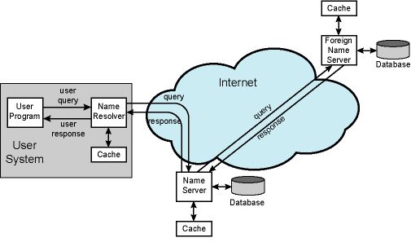
DNS Name Resolution
local

Slide 44
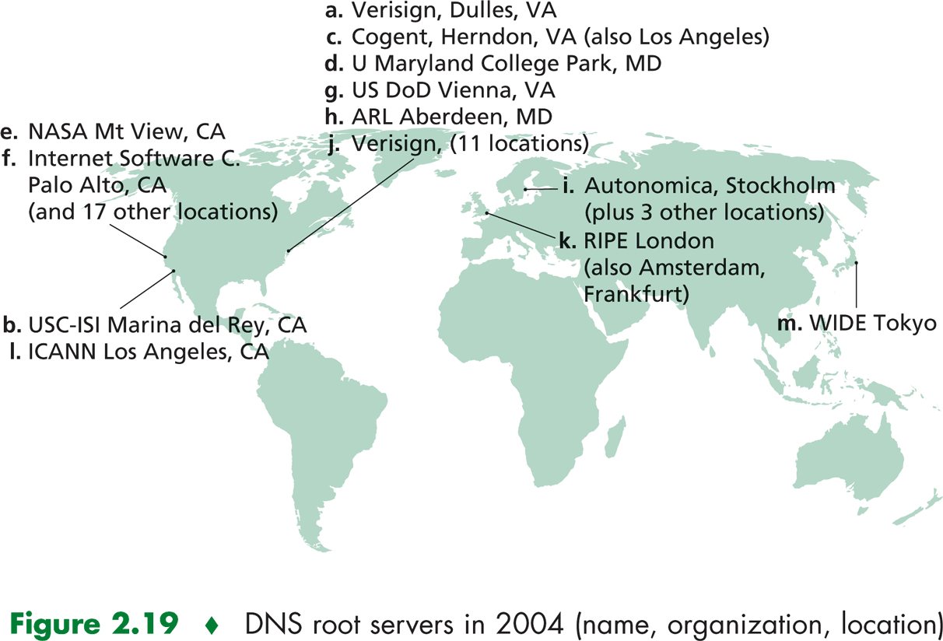
Root Name Servers
servers for TLDs
local server starts with a root server if it does not know anything about the domain to be resolved
  actually there are several of them worldwide
  listed in configuration files of the name servers
Figure from Kurose-Ross

Slide 45
Authoritative Name Servers
A relative concept
  the authoritative name server of a host is the one that keeps the A type RR of that host
Actually a local name server is also authoritative name server for all of the hosts in its zone
In principle, DNS queries aim to reach the authoritative name server for the host to be resolved
  but generally responses come from the other servers that already cached the requested record
    that is why the nslookup responses are mostly non-authoritative
DNS name servers automatically send out updates to other relevant name servers for quick response
  mechanisms designed in RFC 2136 and not in the scope of CS408
nslookup is an application level command line tool for DNS inquiry. It is available in most operating systems (just write “nslookup” at the command line to try).
Notes:
nslookup is an application level command line tool for DNS inquiry. It is available in most operating systems (just write “nslookup” at the command line to try).

Slide 46
Iterative vs. Recursive Queries
Recursive
  If one name server does not know the queried host, it acts like a DNS client and asks to next name server in the zone hierarchy.
  Then sends the result back recursively
Iterative
  If the name server does not know the host, then returns the address of the next server in the zone hierarchy, but does not ask that server.
The name servers learns about the next one in the hierarchy using the glue records.
Remark: Queries and responses are sent over UDP (mostly)
  Why?

Slide 47
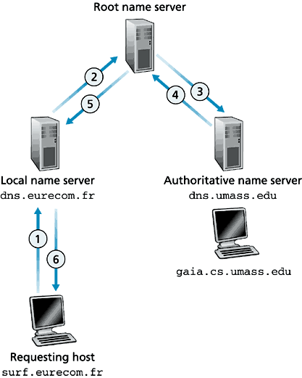
Example - 1
looking for the IP address of gaia.cs.umass.edu
Recursive queries
Let’s think about cached alternatives

Slide 48
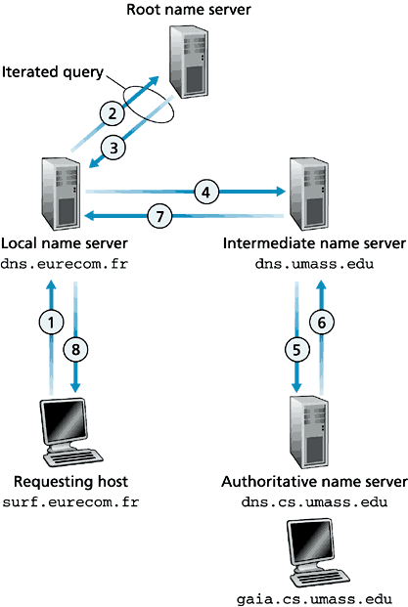
Example - 2
looking for the IP address of gaia.cs.umass.edu
Recursive and iterative queries

Slide 49
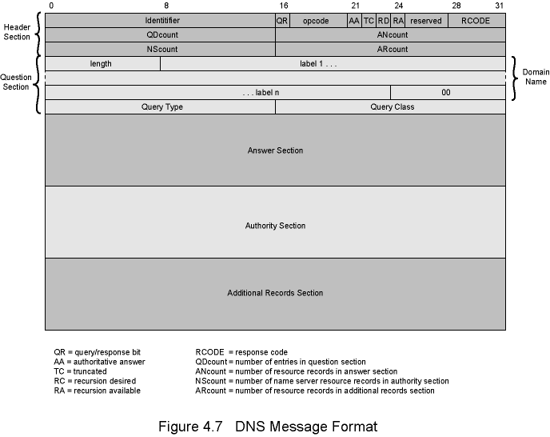
DNS Message Format

Slide 50
DNS Message Fields - Header
Header always present
  Identifier to match queries and responses.
  Query / Response: is message query or response?
  Opcode: Standard or inverse query (address to name), or server status request
  Authoritative Answer: is the response authoritative?
  Truncated: was response truncated
    Requestor will use TCP to resend query
  Recursion Desired
  Recursion Available
  Response Code: e.g. no error, format error, name does not exist
  QDcount: # of entries in question section (zero or more)
  ANcount: # of RRs in answer section (zero or more)
  NScount: # of RRs in authority section (zero or more)
  ARcount: # of RRs in additional records section (zero or more)

Slide 51
DNS Message Fields –
Question and Answers
Domain Name
  Sequence of labels for the domain name to be resolved
  Each label has its length field beforehand
Query Type
  what type of RR is requested?
Query Class: typically Internet.
Answer section contains RRs that answer question
Authority section contains RRs that point toward an authoritative name server

Slide 52
Sockets
covered in labs

